Slide 1
Pattern Recognition
Project 1
Lukas Drexler, Leif van Holland, Reza Jahangiri, Mark Springer, Maximilian Thiessen

Slide 2

1. Task

Slide 3
2. Task

Slide 4
3. Task

Slide 5
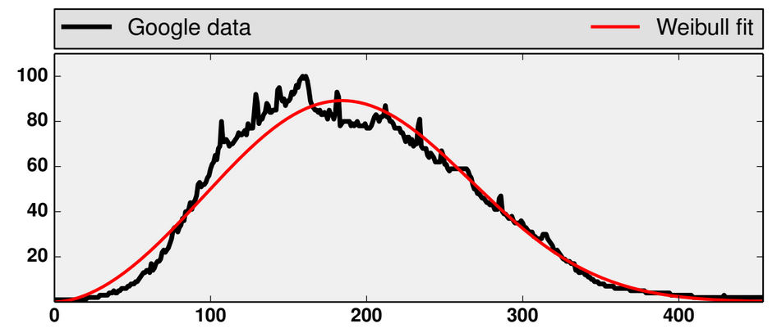
3. Task
Fit weibull distribution
to given data
Estimate parameters
and by
maximum likelihood

Slide 6
3. Task – Using histogram
Use only the histogram data and not the whole
Small example:
is the absolute frequency
is the set of all possible values

Slide 7
3. Task – Using histogram
Sum over D:
Sum over function of D:

Slide 8
3. Task – Newton Method
Applied the method
from the task description
Tried more steps

Slide 9
Task 3 – ODE Method

Slide 10
4. Task

Slide 11
5. Task

Slide 12
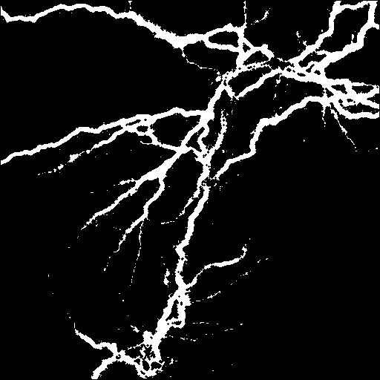
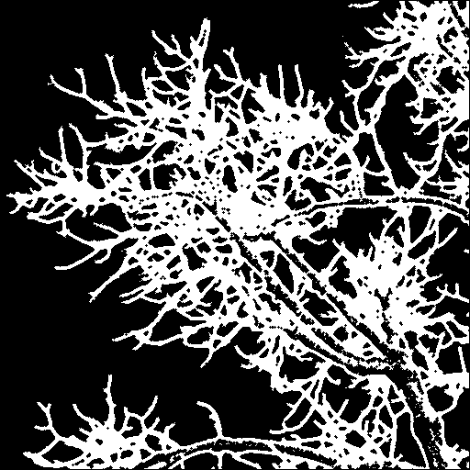
Task 5 – Box counting dimension
calculate box counting dimension
3 steps
  binarize image
  count boxes containing white pixels
  linear regression

Slide 13
Task 5 – Box counting
split matrix into four equally sized submatrices
count number of submatrices containing at least one white pixel
recursively (for the sake of efficiency) split those submatrices

Slide 14
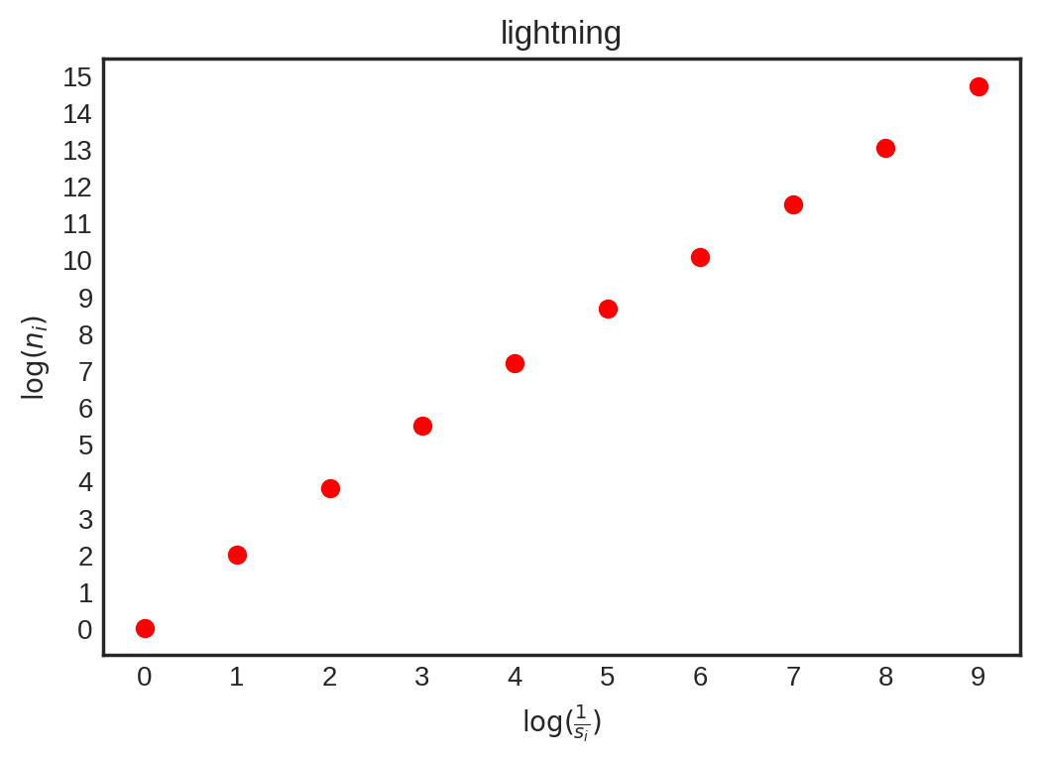
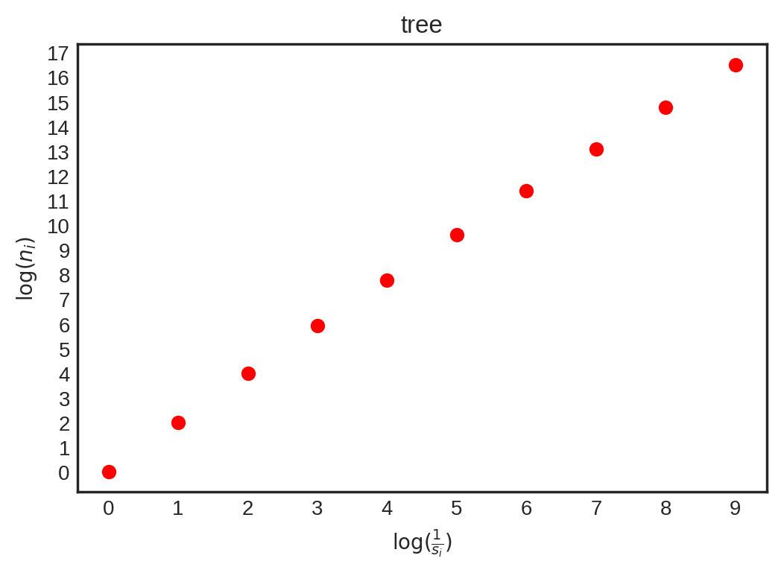
Task 5 – Box counting

Slide 15
Task 5 – Linear regression
regression by least-squares
  find a,b, such that
  is minimized
matrix-vector formulation (as shown in lecture)

Slide 16
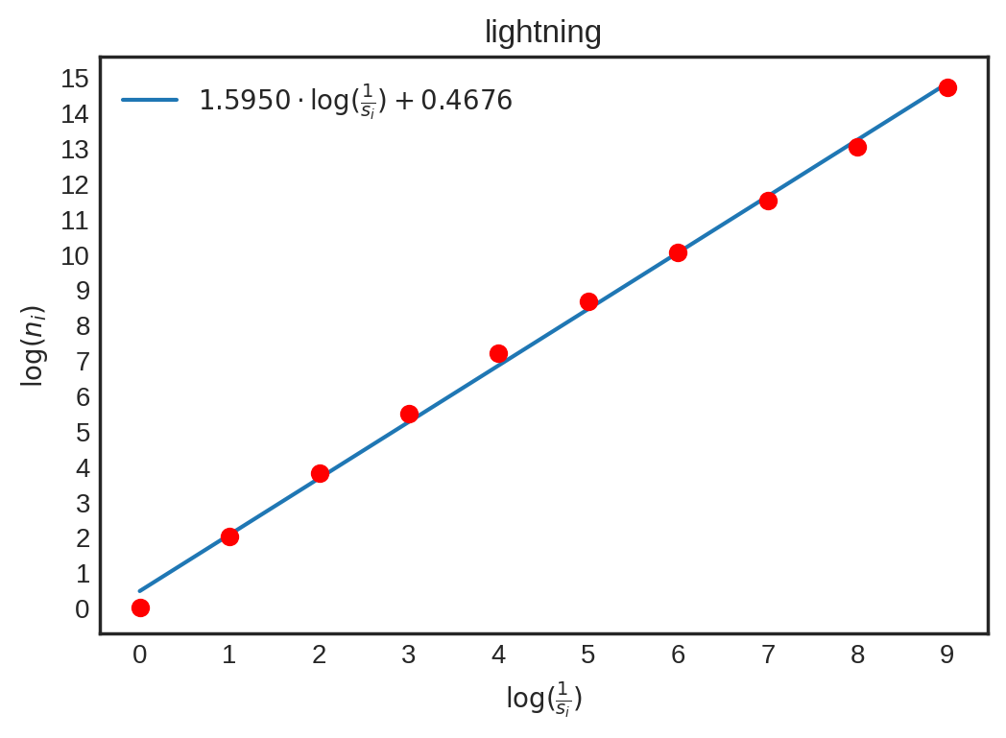
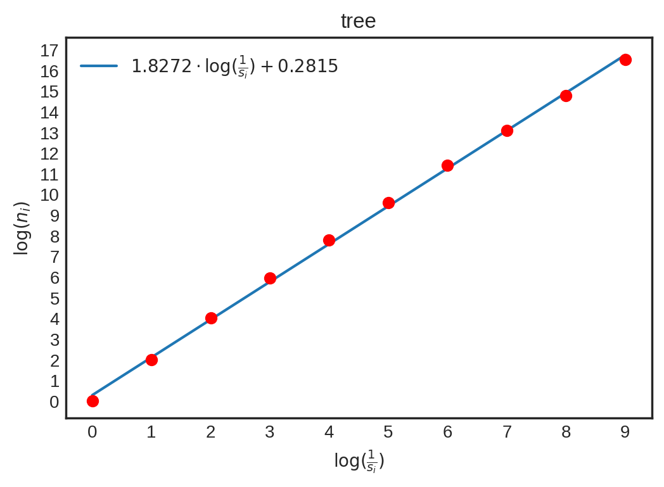
Task 5 – Linear regression
dimension slope
  lightning: D = 1.595
  tree: D = 1.8272

